Slide 1
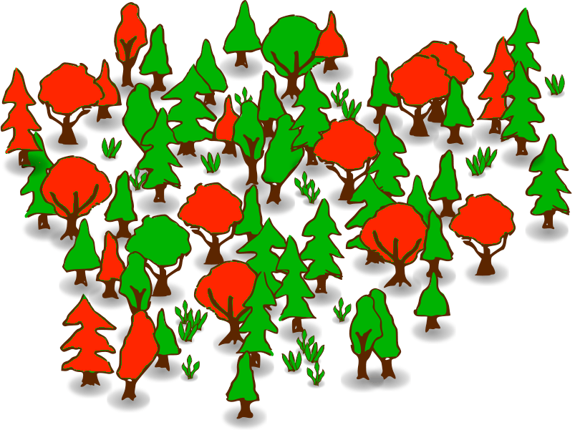
What are Random Forests?

Slide 2
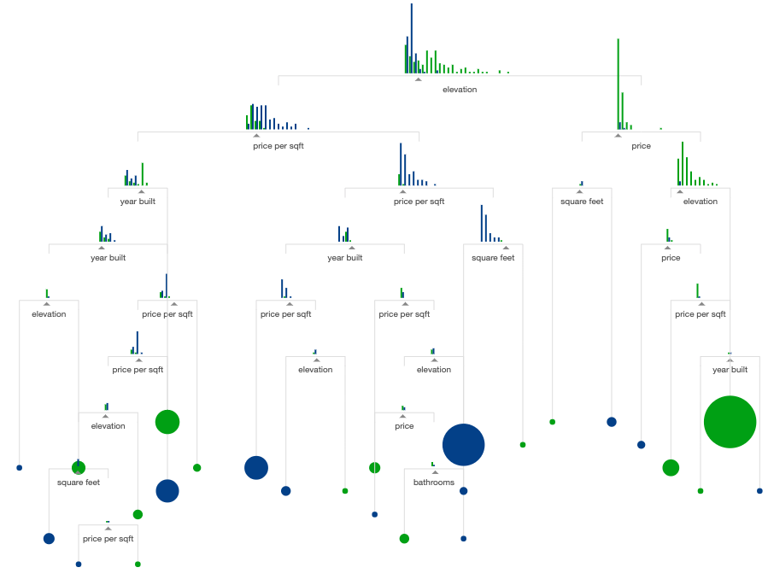
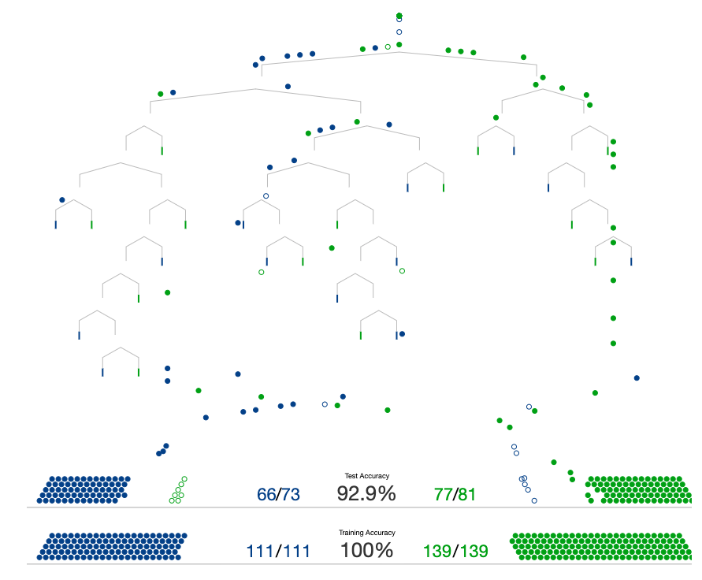
What is a Decision Tree?
Nonlinear method for classification and regression
20 questions game analogy: You have in your mind a binary object. A decision tree is an expert questioner who can ask the optimal set of questions to predict your object with 90% accuracy.

Slide 3
What is a Random Forest?
- Randomized decision trees on random subsamples.
- Key idea: The average opinion of dumb questioners (weak learners) is better than the opinion of one expert questioner.

